Slide 1


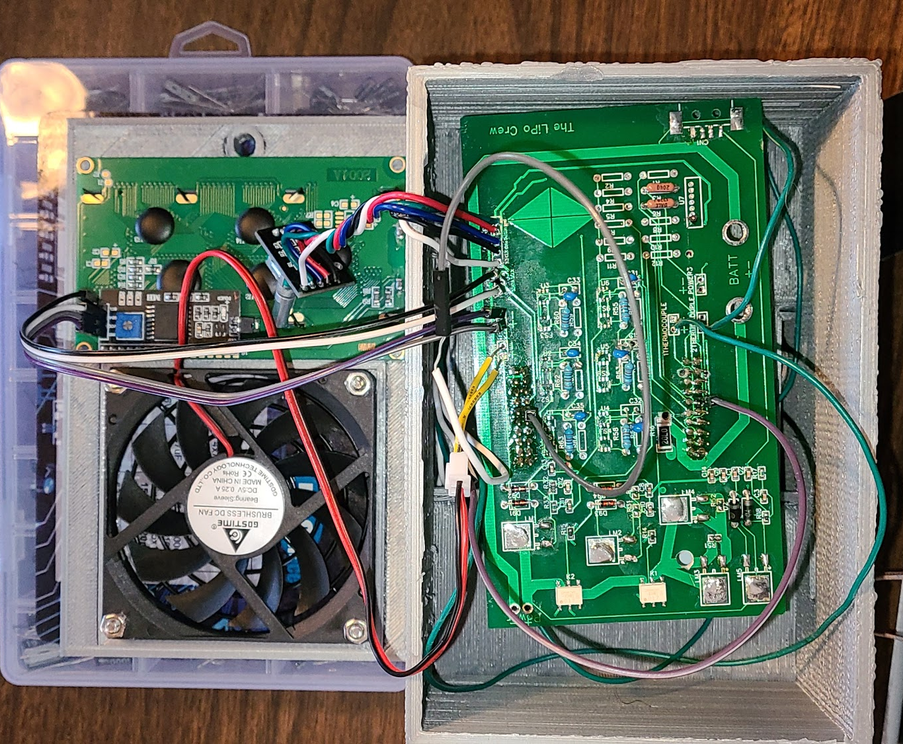
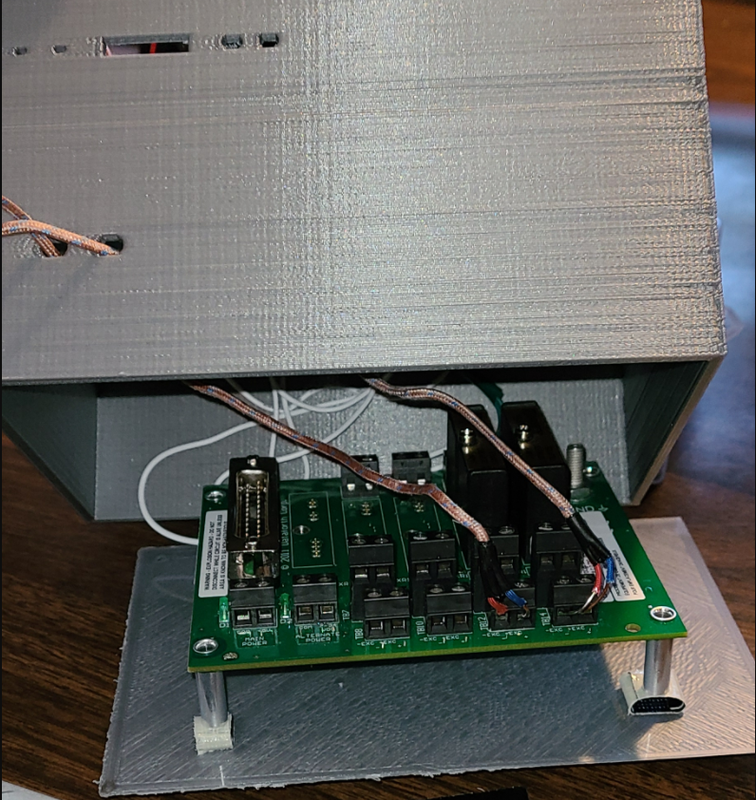
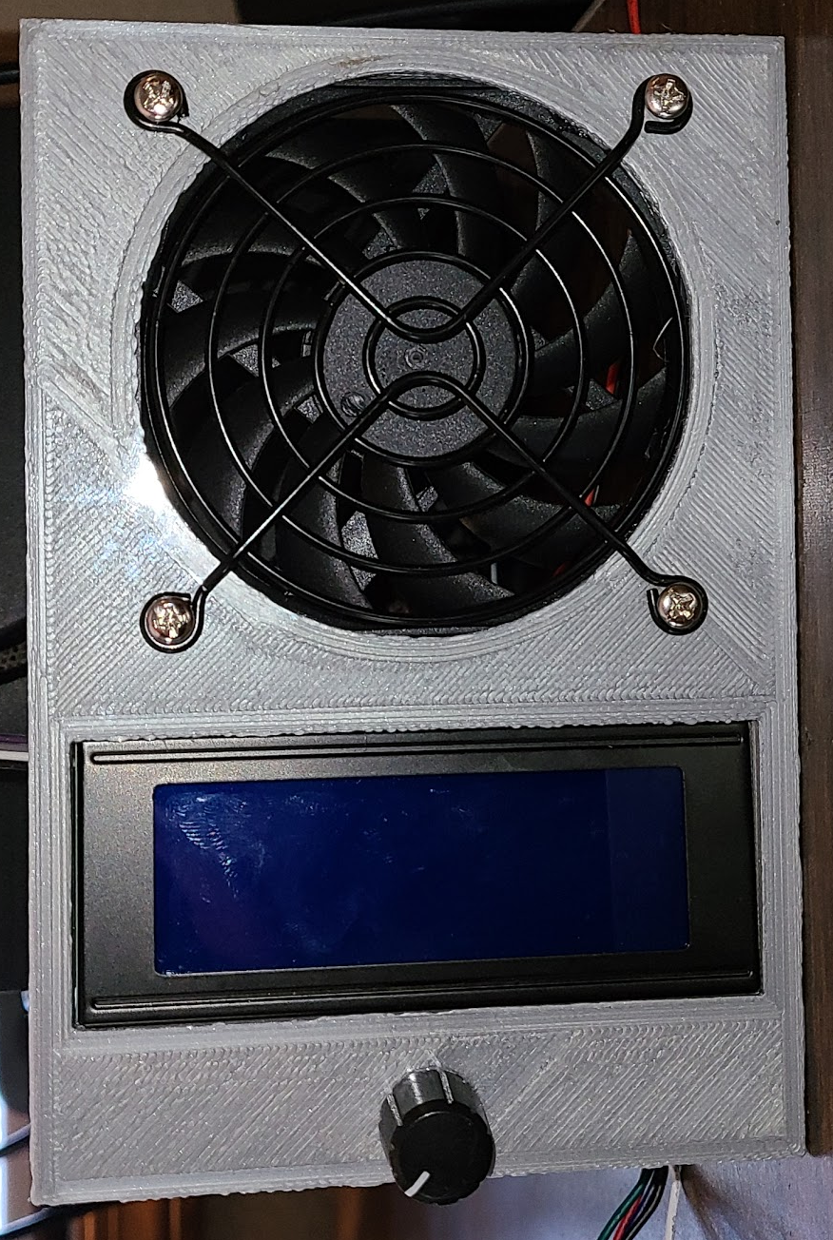
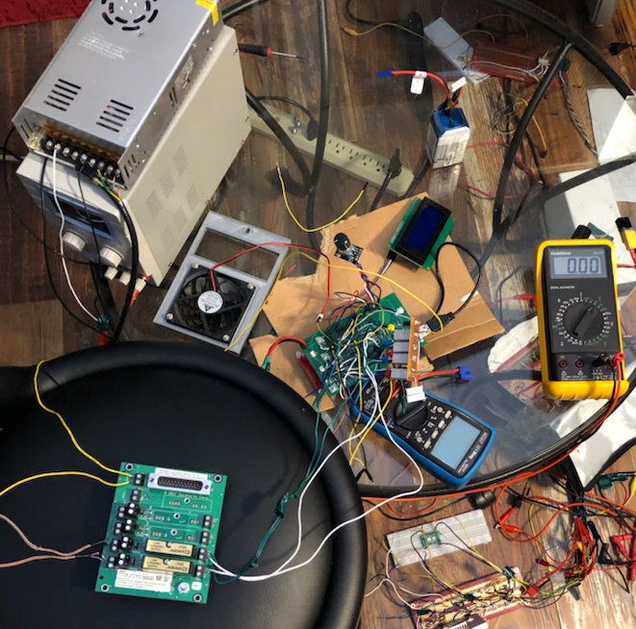
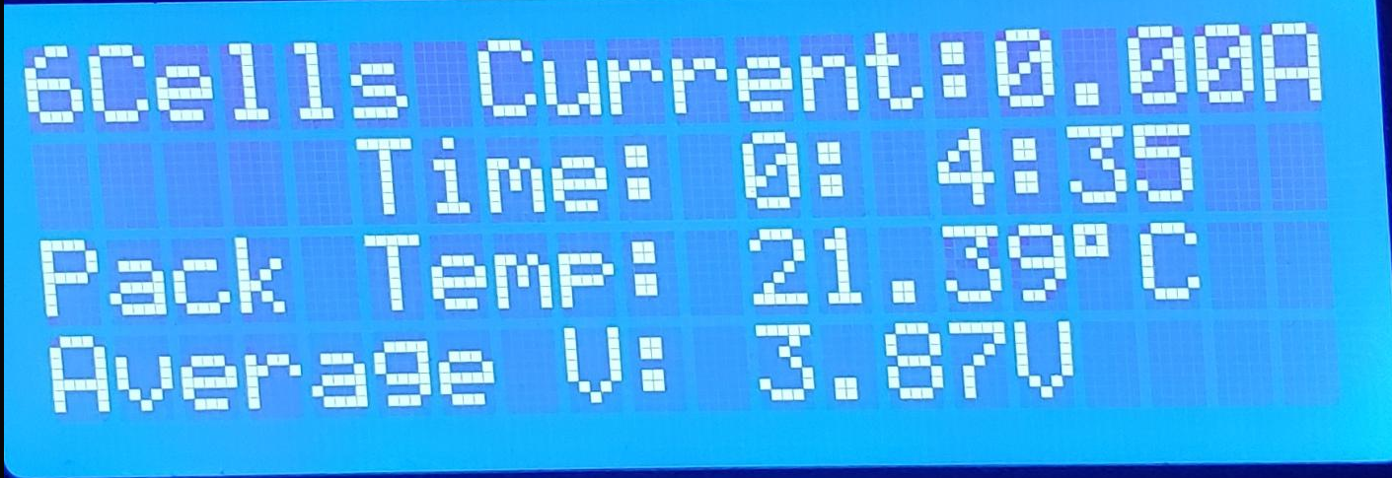

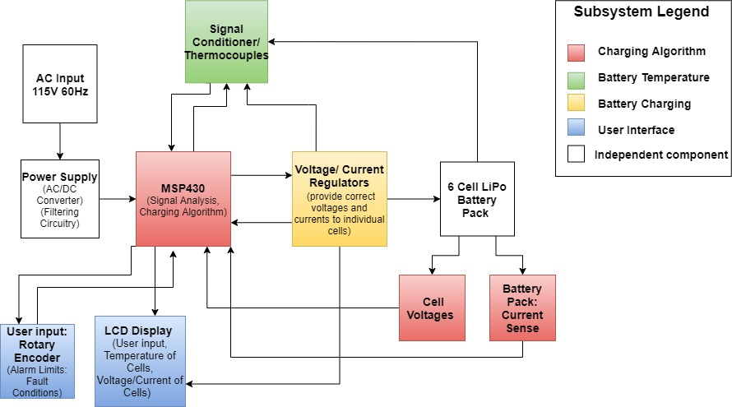
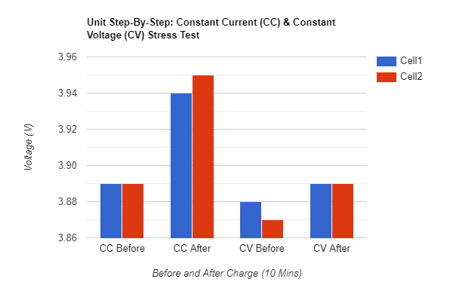
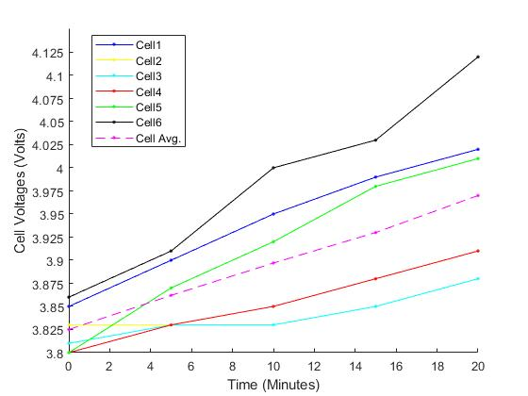
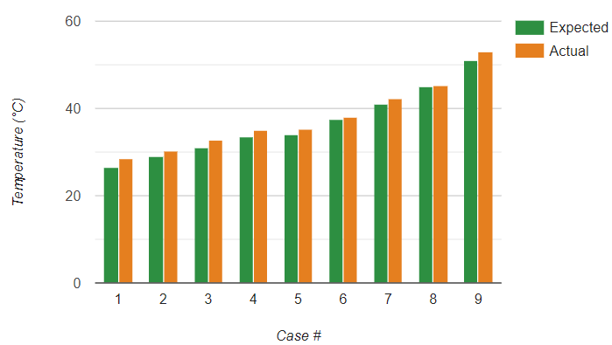

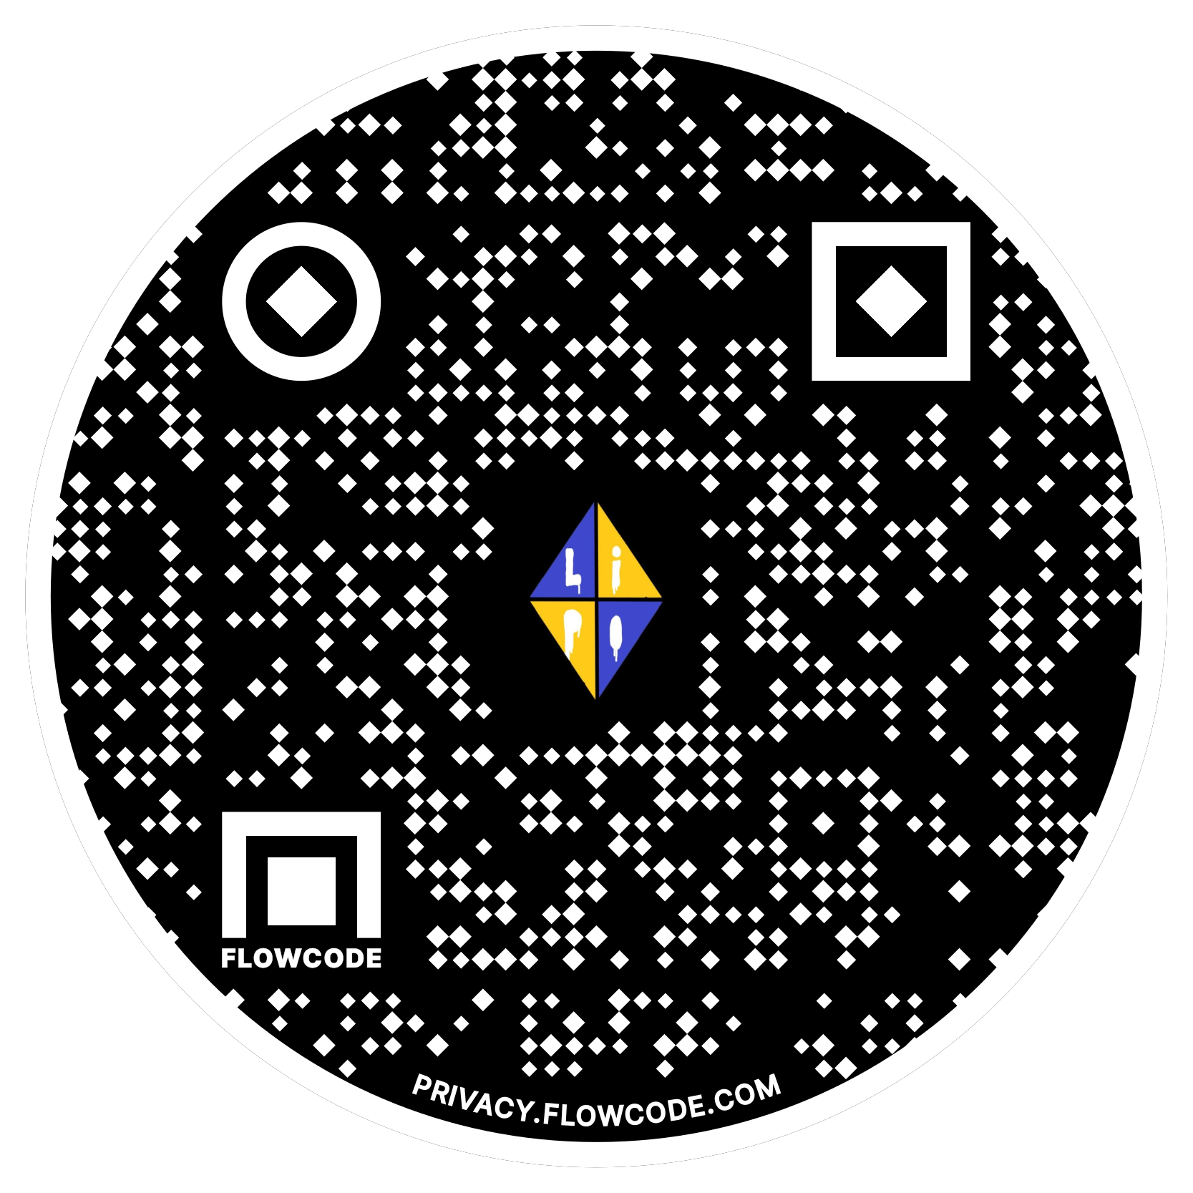

6-Cell Lithium Polymer Battery Charger
The LiPo Crew
Jace C. Jenkins, Jonathan S. Ciulla, Elray K. Santiago Jr., Luis Camargo
Abstract
Final System Design
Problems and Solutions
The technological advancements in battery design have necessitated efficient, safe, and reliable battery chargers, particularly in Lithium Polymer (LiPo) battery applications. LiPo batteries are inherently hazardous and require precise measurements to verify safe working conditions. Our team’s design was centered around a Texas Instruments MSP430 microcontroller that facilitated the safety requirements by utilizing a custom battery charging algorithm based upon user-defined fault conditions and default current and voltage thresholds. The charging algorithm employed by the MSP430 enabled efficient data processing from a multitude of analog inputs, including individual cell voltages, battery pack temperature, and the current supplied to the battery. With the use of Dataforth Corporation’s industry-leading analog signal conditioning modules, our battery pack temperature measurements are able to achieve greater accuracy. The team’s design procedural fluency aided in our ability to translate concepts into a final product. Through validation and verification testing, the design experienced alterations in both hardware and software due to redundancies. By doing so it lead to achieving an optimized design that provides the user with the utmost safety and reliability while charging a six-cell LiPo battery.
Problems
Unable to read battery charge current
Thermal cutoff for the current regulator
Incorrect cell count autodetection
Incorrect PCB layout (Improper grounding)
Solutions
Due to multiple delays and circuit complications with our prototyping solutions, the LiPo Crew had decided to cut out the current sensor from our design.
Heat sinks were implemented to dissipate heat in addition to our 5V fan for system cooling.
To fix this issue the LiPo Crew changed the threshold voltage for the charging algorithm via coding.
The LiPo Crew had to reevaluate our schematic and PCB layout through the EasyEDA software. From here we found multiple grounding errors.
System Architecture
Figure 2. Cover including the 5V fan, LCD, and rotary encoder for user interfacing and system cooling (top view)
Conclusion
Figure 3. Final printed circuit board (PCB) created from JLC PCB, and full system integration inside of the 3D printed casing created with SolidWorks software (top inside view of 3D printed casing)
Figure 4. Thermocouple module located under the MSP430 and main PCB (bottom inside view of 3D printed casing)
While battery technology continues to advance, so will the safety that comes with the danger of using Lithium Polymer batteries. Throughout the year, The LiPo Crew has learned valuable lessons pertaining to circuit design, code development, testing, debugging with software interfaces, and circuit issues. Implementation and integration of the full circuit after having multiple subsystems on protoboards posed a challenge due to various oversight during the PCB layout. Another challenge our team faced was inaccurate cell voltage readings due to a noisy environment. The LiPo Crew resolved this issue by employing low pass filters on all of the cell voltage inputs to the MSP430 microcontroller. As a team, The Lipo Crew put forth their best effort to continue the trend of increasing battery charging safety by making it paramount in our system requirements.
System Architecture
Figure 6. LCD displaying the current, charge time, average battery temperature and the average cell voltage
Figure 7. LCD displaying the six cells connected, current, and voltages of each cell.
3D Printed Case Layout
References
Figure 5. Full system test set-up with multimeters for voltage level verification
The LiPo Crew created a 3D printed case to house the PCB and MSP430 on the top level
The bottom level encases the thermocouple module
The top of the case has a fan to provide active cooling primarily for the voltage and current regulators
Below the fan is the LCD and rotary encoder for ease of use with the user interface
[1] D. Xu, L. Wang and J. Yang, "Research on Li-ion Battery Management System," 2010 International Conference on Electrical and Control Engineering, Wuhan, 2010, pp. 4106-4109, doi: 10.1109/iCECE.2010.998.
[2] P. Weicker, “A systems approach to lithium-ion battery management,” Boston: Artech House, 2014.
Results
Figure 1. Full System Architecture
Acknowledgements
Our design consists of subsystems based on the charging algorithm, battery temperature, battery charging, and user interface.
The charging algorithm is implemented via the MSP430 microcontroller. The algorithm is based upon the six cell voltages. If all cells are below 4.1V, the charger provides the battery with constant current. Once a cell reaches a voltage of 4.1V, the charger operates in constant voltage until the current falls below 125mA. Once the current has decreased to that point, the battery has completed its charging cycle.
Battery temperature is a key parameter to measure in our system to maintain a safe user experience. Our battery temperature subsystem is comprised of two Dataforth Corporation SensorLex 8B isolated analog signal conditioners to provide a noise free signal to the microcontroller for a highly accurate temperature measurement.
Our battery charging system is a culmination of one voltage regulator and two current regulators which are controlled by the microcontroller dependent on the charging algorithm.
A user interface has been achieved through the use of a rotary encoder to allow for the user to select a safe temperature threshold, as well as a timer limit. All information is displayed on a Liquid Crystal Display (LCD) in five second intervals. Data presented on the LCD includes the number of cells connected, individual cell voltages, battery current, battery pack temperature and the true charge time.
Constant Current & Constant Voltage Stress Tests: 2-Cell Battery
Constant Current Charge Cycle: 6-Cell Battery
Average Battery Pack Temperature Test
Client: Dr. John Lehman (VP Product Development Dataforth Corporation)
Dataforth Corporation
Faculty Consultation: Dr. Robert Severinghaus
Mahsa Keshavarz
Team & Client Websites
For more information on the LiPo Crew please visit our website by scanning the QR code below.
For more information on our client Dataforth Corporation please visit our client’s website by scanning the QR code below.
Figure 8. Cell voltages prior to and after CC & CV tests. This test was conducted using a two cell battery for safety reasons therefore, only two cells are represented in this figure.
Figure 9. Cell voltages during constant current charge phase. The test plots the instantaneous voltage levels over a time of 20 minutes.
Figure 10. Average temperature measurement vs. expected temperature. Tests were conducted by increasing one thermocouple over time and leaving the other at a constant 22.0°C.
Constant current phase charged cells for an average of 55mV
Constant voltage phase charged cells for an average of 15mV
The cell voltages increased on average by 35.75mV per 5 minutes
2/3 of our test cases were successful
The unsuccessful test cases failed to fall within 1.5° of the expected temperature

